Slide 1

Exploration of Intrinsic Disorder Regions through Classification of Intrinsically Disordered Proteins Using PPI Network Structure and Sequence Attributes: A Case Study
Milana Grbić, Milan Predojević, Nenad Vilendečić, Dragan Matić
Faculty of Natural Science and Mathematics, University of Banja Luka
Belgrade Bioinformatics Conference 2024, Belgrade, Serbia,
June 17-21, 2024

Slide 2
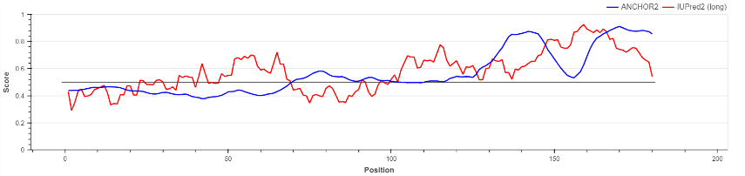
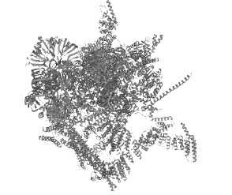
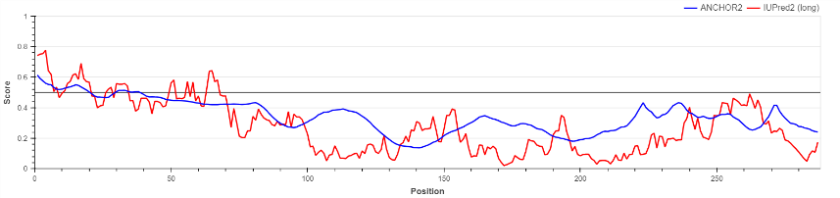
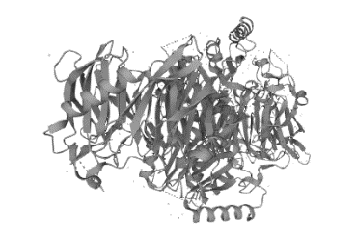
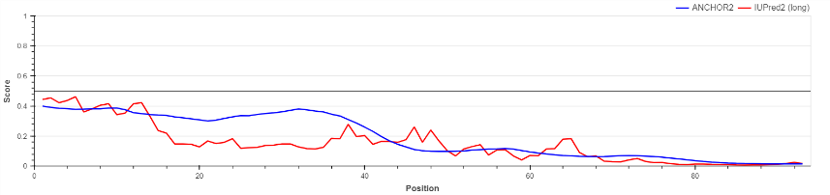
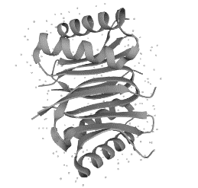
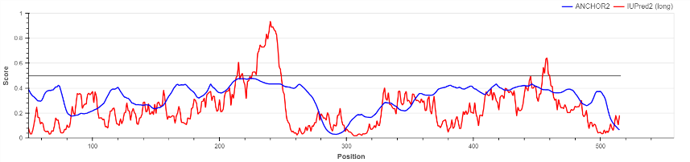
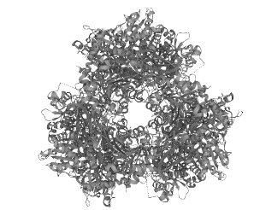
Protein | IUPred2A | Function | Structure | Subcellular Location
YNL245C |  | Involved in pre-mRNA splicing. |  | Nucleus
YDL201W |  | Methyltransferase that catalyzes the |  | Nucleus
YDR424C |  | non-catalytic accessory components of the cytoplasmic dynein complex |  | Cytoplasm, cytoskeleton Nucleus, nuclear pore complex
YKL103C |  | Resident vacuolar enzyme that catalyzes the removal of amino acids from the N-terminus of peptides and proteins |  | Vacuole

